Slide 1

Keyless Authentication using Azure Managed Identity
Garry Trinder
Solutions Architect, CPS
16/12/2020

Slide 2




About me – Garry Trinder
Solutions Architect, CPS
1 x Microsoft 365 Office Development MVP
Microsoft 365 Patterns & Practices (PnP) Team Member
PnP CLI for Microsoft 365 Maintainer
Twitter: @garrytrinder
GitHub: @garrytrinder
Blog: https://garrytrinder.github.io
GreyHatBeard Podcast Co-Host

Slide 3
Agenda
What is the problem we solving?
Managing Credentials
Azure Managed Identity
Demos
Access Azure Key Vault from Azure Logic Apps using Azure Managed Identity
Call Microsoft Graph from an Azure Logic App using Azure Managed Identity
Call Microsoft Graph from a DotNetCore Azure Function (v3) using Azure Managed Identity
Summary

Slide 4
Managing credentials
How do you manage credentials in your code?
How do you manage credential expiration and renewal?
Azure Key Vault provides a way to securely store credentials but where do you store the credentials to connect to Key Vault?

Slide 5
Azure Managed Identity
“Managed identities for Azure Resources” formerly Managed Service Identity (MSI)
Authenticate with any Azure AD backed service
No credentials in code
Automatic credential rolling
No additional cost
Role Based Access Control
Notes:
Managed identities use certificate-based authentication.
Each managed identity’s credential has an expiration of 90 days and it is rolled after 45 days.

Slide 6
Credentials…
Where we are going…
we don’t need credentials…

Slide 7
Two identities
A system-assigned managed identity is enabled directly on an Azure service instance
Cannot be shared
Lifecycle is tied to a single Azure resource
A user-assigned managed identity is created as a standalone Azure resource
Can be shared
Lifecycle is independent to resources

Slide 8
DEMO Access Azure Key Vault from Azure Logic Apps using Azure Managed Identity

Slide 9
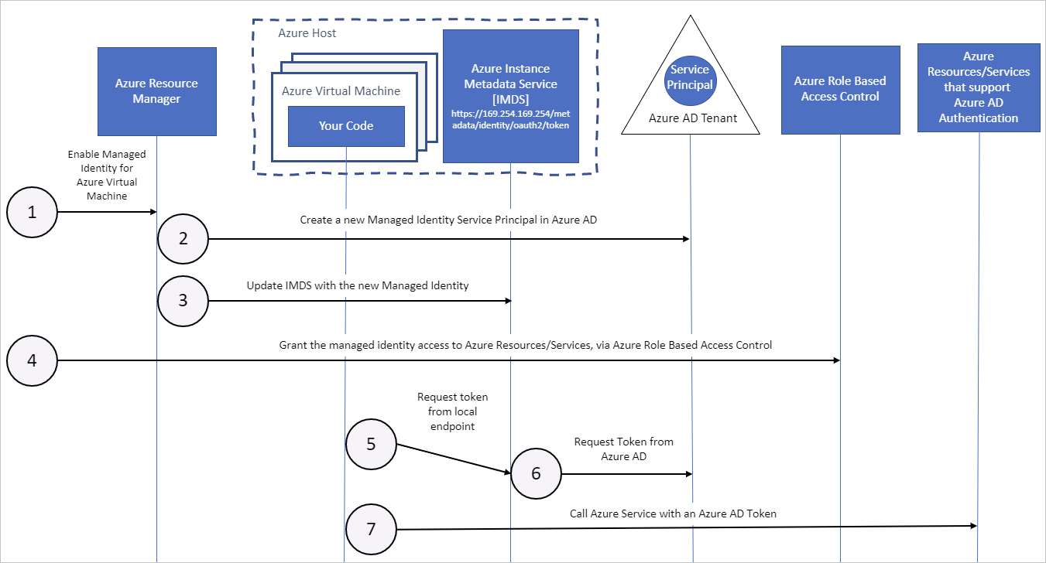

Slide 10
DEMO Call Microsoft Graph from an Azure Logic App using Azure Managed Identity

Slide 11
DEMO Call Microsoft Graph from a DotNetCore Azure Function (v3) using Azure Managed Identity

Slide 12
Summary
No need to store credentials to authenticate
Let Azure handle credential management with no extra cost
Simplify app-only scenarios to Azure AD backed APIs
Use ‘CLI for Microsoft 365’ to update App Role Assignments
Creating App Role Assignments require Azure Global Admin role
Permissions are locked after first use!
Use Microsoft.Azure.Services.AppAuthentication package & Azure CLI for Azure Function local development

Slide 13

Samples & Resources
https://github.com/garrytrinder/keyless-auth-managed-identity

Slide 14
Think of your next project …
Could you benefit from using Azure Managed Identity?

Slide 15
Thank you!
Garry Trinder
@garrytrinder

